Slide 1
Program 8 Project Groups

Slide 2
Problem Set
I am working for a professor to develop a program to sort students into their desired project groups with the highest level of satisfaction. Each student will pick 3-5 groups ranked from 1st preference to last preference. Groups are limited in size.

Slide 3
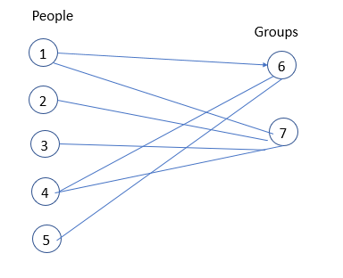
You set it up as a bipartite graph, with people and groups. For simplicity, I’ll assume 5 people and two groups.

Slide 4
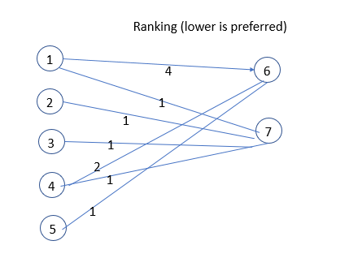
In the figure below, each edge is labeled with a ranking (1 is best) which functions as a cost. You will notice that some people didn’t give a second choice. Person1 gave group six a rank of 4 to indicate his low preference.

Slide 5
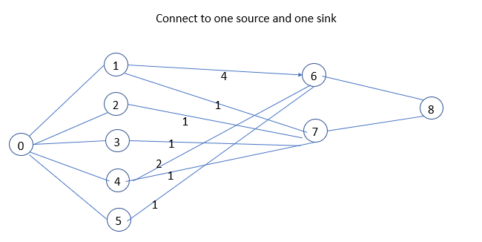
To turn it into a max flow problem, we need to have one source and one sink.

Slide 6
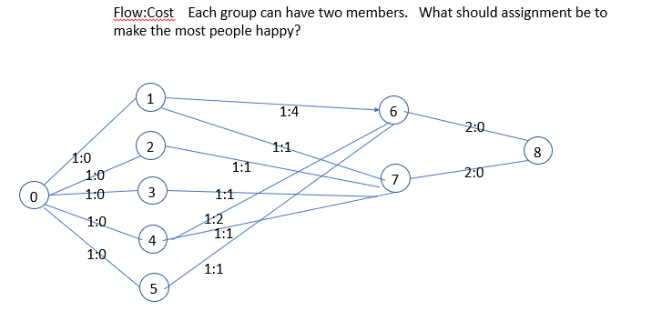
We need to add capacity (not just cost). Capacity is 1 for all arcs, except for the groups. The capacity of each group is shown below as 2. If you wanted each person to belong to two groups, how would that be done?

Slide 7
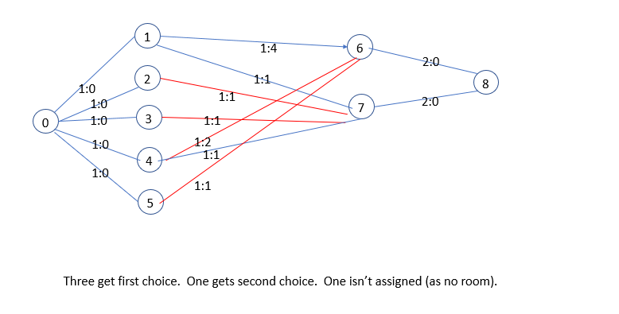
Notice the assignment below maximized the flow (as both groups are full), but the cost is only 5. That is the goal of a min-cost max flow: find the cheapest way to maximize flow.

Slide 8
Min cost Max Flow
We modify the network as follows: for each edge (i,j) add the reverse edge (j,i) to the network with the capacity (U) of 0 and the cost C(j,i) = -C(i,j). This indicates that going backwards along an edge removes the cost incurred by going forward. In addition we will always keep the condition F(j,i) = -F(i,j) true during the steps of the algorithm. This means that if you push flow forward on an edge, you can push the same amount backwards on the reverse edge. Since the capacity of the reverse edge is 0, having a negative flow slows flow (as the residual is capacity – flow). So if the edge (I,j) has capacity 1 and flow 1, there is no more flow that can go forward, but on the reverse edge (having capacity 0 and flow -1), the residual is 0-(-1) or 1.
We define the residual network just like in Ford Fulkerson. The residual network contains only unsaturated edges (flow < capacity) and the residual flow is U(i,j)-F(i,j).
Now we can talk about the algorithms to compute the minimum-cost flow. At each iteration of the algorithm we find the shortest path in the residual graph from source to sink. However, we look for the shortest path in terms of the cost of the path, instead of the number of edges. If there doesn't exists a path anymore, then the algorithm terminates. If a path was found, we increase the flow along it as much as possible (i.e. we find the minimal residual capacity of the path, and increase the flow by it, and reduce the back edges by the same amount). We repeat until there is no more flow possible.

Slide 10
found flow 1: 0 5 6 8
found flow 1: 0 4 7 8
found flow 1: 0 3 7 8
found flow 1: 0 2 7 4 6 8 // Since reverse edges are used, you undo a previous assignment
group1.txt Max Flow SPACE 4 assigned 4
Edge (0,2) assigned 1(0)
Edge (0,3) assigned 1(0)
Edge (0,4) assigned 1(0)
Edge (0,5) assigned 1(0)
Edge (2,7) assigned 1(1)
Edge (3,7) assigned 1(1)
Edge (4,6) assigned 1(2)
Edge (5,6) assigned 1(1)
Edge (6,8) assigned 2(0)
Edge (7,8) assigned 2(0)
TotalCost = 5

Slide 11
Hints:
I found it simpler to have a residual graph that just showed how much flow was allowed on each edge. Costs never change in the graph. I didn’t have to remember whether I was going forward or backward along an edge if I only looked at the residual graph.
group7.txt is a graph which models a different application, but still wants a minCost, max flow solution. The cost is the cost per unit of flow. You find the minimum cost to push one unit of flow through the graph, BUT if you can push more than one unit, you do so as you won’t find a better path.

